Slide 1

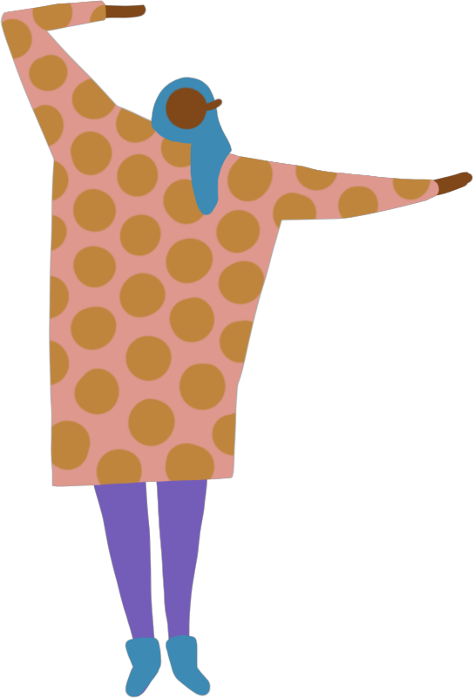

Get strong, increase
balance, feel good
. . . and prevent falls
[Presenter name]
[Presenter title and organization]
[Date]

Slide 2


The NO|FALLS Minnesota Campaign is a multi-organizational
collaboration led by Juniper.
The collaboration includes the
Minnesota Department of Health, Minnesota Board on Aging,
Minnesota State Fire Marshal, Minnesota Association of Area Agencies on Aging and Juniper program providers in 16 regional healthcare providers and
86 community-based program providers.

Slide 3

What we’ll cover
Why it matters
Check your risk
Simple ways to reduce risk
Resources for next steps

Slide 4



Falls are Common
Barbara Walters
Ed McMahon
Nancy Reagan
Notes:
Falls are common.
On January 19th, 2013, veteran news journalist Barbara Walters, 83, missed a step and fell on a staircase at the British Ambassador’s residence in Washington D.C. prior to President Obama’s second inauguration. Hospitalized to treat a cut on her forehead and subsequent low-grade fever.
Ed McMahon, Johnny Carson’s former sidekick tripped and fell in his home on March 4, 2005. McMahon, 82 suffered from a mild concussion and a gash in his head that required stitches. He was released from the Los Angeles area hospital a few days later.
Nancy Reagan, at 84 years old was briefly treated in a British hospital after she fell in her hotel room in London.
http://stopfalls.org/what-is-fall-prevention/famous-fallers/

Slide 5
Falls in 2018
More than 8 million falls required medical attention.
More than 32,000 older adults died from a fall.
Source: https://www.cdc.gov/steadi/
Notes:
Source: https://www.cdc.gov/steadi/

Slide 6
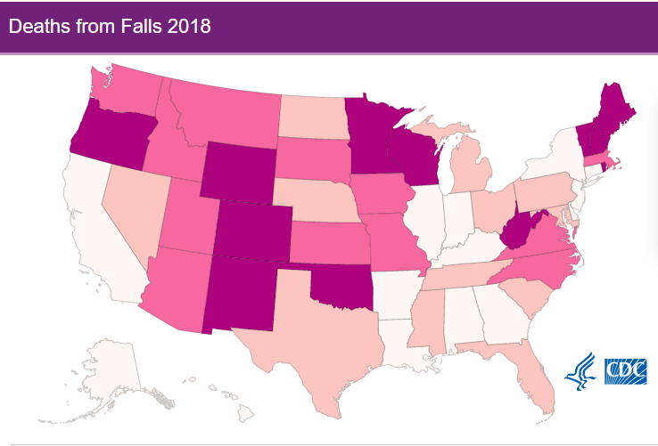
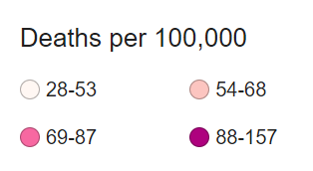
Where does Minnesota rank?
3
4
2
1
3
1
5
4
2
No. 4 in the country for deaths from falls
5
Source: CDC
Notes:
Falls are the leading cause of injury related-death among adults 65 and older. This map shows the age-adjusted fall death rate per year across the United States. How do you think MN ranks?
MN ranks 4th in fall-related deaths.
Wisconsin - 157
Vermont - 142
Maine - 140
Minnesota – 124
Colorado – 112
Why do you think that is? Many people say ice and snow, but if that were the case we would see an increase of fall-related deaths over the winter and we don’t, the rate of fall-related deaths stays steady throughout the year. What do we do during the winter when it is cold and icy? We stay home, by staying home we are not as active and we lose strength, endurance, flexibility and balance. That is what experts believe contributes to the higher rate.

Slide 7
Falls are a normal
part of aging.
True or False?
Notes:
False. Falls are common, but they are not a normal part of aging. Improving strength and balance, managing medications, regularly getting your vision checked and making your living environment safer are ways to prevent falls. Many people fear falls, so they limit their activity levels to reduce their risk of fallin, which can lead to reduced mobility and loss of physical fitness, which in turn increases the actual risk of falling.

Slide 8
Check Your Risk for Falling
Answer “Yes” or “No” for each statement below.
Yes (2) | No (0) | I have fallen in the past year.
Yes (2) | No (0) | I use or have been advised to use a cane or walker to get around safely.
Yes (1) | No (0) | Sometimes I feel unsteady when I am walking.
Yes (1) | No (0) | I steady myself by holding onto furniture when walking at home.
Yes (1) | No (0) | I am worried about falling.
Yes (1) | No (0) | I need to push with my hands to stand up from a chair.
Yes (1) | No (0) | I have some trouble stepping up onto a curb.
Yes (1) | No (0) | I often have to rush to the toilet.
Yes (1) | No (0) | I have lost some feeling in my feet.
Yes (1) | No (0) | I take medicine that sometimes makes me feel light-headed or more tired than usual.
Yes (1) | No (0) | I take medicine to help me sleep or improve my mood.
Yes (1) | No (0) | I often feel sad or depressed.
Total: _______ |  | Add up the number of points for each “yes” answer. If you scored 4 points or more, you may be at risk for falling.
Notes:
Before we dive into ways to reduce risk of falling, let’s take a moment to assess our levels of risk. Before this presentation I distributed to each of you a copy of the Steadi self-assessment from the CDC. Let’s go through it together.
Steadi assessment: https://www.cdc.gov/steadi/pdf/STEADI-Brochure-StayIndependent-508.pdf
(Read through each statement and why it matters)
Why it Matters:
People who have fallen once are likely to fall again.
People who have been advised to use a cane or walker may already be more likely to fall.
Unsteadiness or needing support while walking are signs of poor balance.
This is also a sign of poor balance.
People who are worried about falling are more likely to fall.
This is a sign of weak leg muscles, a major reason for falling.
This is also a sign of weak leg muscles.
Rushing to the bathroom, especially at night, increases your chance of falling.
Numbness in your feet can cause stumbles and lead to falls.
Side effects from medicines can sometimes increase your chance of falling.
These medicines can sometimes increase your chance of falling.
Symptoms of depression, such as not feeling well or feeling slowed down, are linked to falls.
If you haven’t already, please take a moment to total your results. If you score is 4 points or more, you may be at risk for falling. You can use this assessment to start a conversation with your doctor, and to guide which risk reduction steps you may want to take as we go through the rest of the presentation.

Slide 9
Reduce Your Risk
of Falling
Be safe at home
Enjoy the outdoors
Move your body
Check your vision
Know your medications
Care for your feet
Notes:
Let’s talk about simple ways to reduce your risk. All of these strategies are free or low-cost.
Indoor and outdoor safety and hazards
Foot care and foot wear
Exercise – muscle weakness and balance
Medication
Eye site and lighting
Okay, so let’s get started.

Slide 10
Be Safe at Home
Remove throw rugs
Clear clutter
Watch for pets
Brighten your home
Take your time
Source: American Journal of Lifestyle Medicine
Notes:
Many of us think that if we stay home, we won’t fall. A nationwide analysis of the location of an older adult’s fall that resulted in emergency department visits found that 79% of those falls occurred in the home. Adjustments to our home can make a big impact to prevent falls!
Let’s start with some general tips which are great in any area of the home.
First, clear your floors. Minnesotans love their throw rugs. With a 4-season climates, throw rugs feel essential to ensure that the weather outside doesn’t get tracked in. Throw rugs are also a tripping hazard. Remove unnecessary throw rugs to help reduce the risk of falling, or secure rugs to the floor with adhesives. Make sure cords are tucked away from walking paths.
(personal example) Clear clutter, especially on the steps. My colleague had a two-story home, and she and her husband would put items on the steps to be carried upstairs later. Needless to say, later rarely came, their steps were always cluttered, and they would trip on things going up and down.
When you walk through your home, are their clear walking paths? Or is their furniture in the way? Consider rearranging furniture to allow a clear paths.
Does anyone have pets, or visit someone who has pets? Where do pets like to be? At our feet! Its important to watch out for pets, their toys, and food bowls as they can be tripping hazards.
I grew up in a home where saving electricity was a top priority. It felt like as soon as I walked into a room and turned a light on, my dad was hollering at me to turn it off. My need to conserve electricity has followed me into adulthood, but I’ve learned that turning on lights is important so that we can see where we are walking and not fall. We can use nightlights to guide our walking paths at night and keep a lamp and glasses (if we have them) within easy reach of our bed or favorite chair.
In general, it is a good idea to slow down and take our time moving through our home. As the fall risk assessment mentioned, rushing increases the risk of falling. We don’t need to rush to answer the phone or door, that person can wait a few extra moments while we take our time.

Slide 11
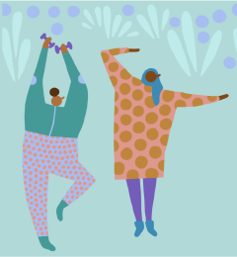
Fall-Free Bathroom
Non-slip mats
Bench or shower stool
Grab bars
Seat riser or higher toilet
Frequently used items in easy reach
Notes:
There are some specific changes that we can make to our bathrooms to help reduce the risk of falling
Use a non-slip mat in the tub or shower
Use a bench or shower stool and a handheld shower head while bathing
Install grab bars near the toilet and shower. Towel bars are not the same as grab bars.
(Personal story) I had a coworker who had back surgery a few years ago. She crossed her t’s and dotted her I’s to make sure she had her home ready for her recovery, but she forgot about grab bars. On her second day home she slipped while getting out of the shower, grabbed the towel bar for stability and pulled the towel bar right out of the wall.
Many of our toilets are low to the ground. Purchase a taller toilet or put a seat riser on the toilet you have to make it easier to stand up.
Keep soaps and toiletries within easy reach, it makes sense for the shampoo and bar soap you use every day to be easy to get to. If your shampoo is on the bathroom counter, you could lose your balance while reaching for it from the shower. Remove excess toiletries aka clutter.

Slide 12
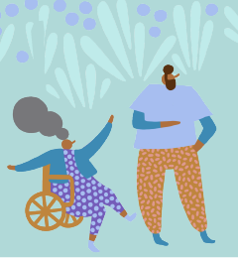
Fall-Free Living Spaces
Handrails on both sides of the stairs and steps in good repair
Step stools instead of a chair
Remove throw rugs
Use chairs without wheels
Frequently used items within easy reach
Clear walking paths
Notes:
Handrails on at least one side of the stairs is a must. Handrails on both sides of the stairs is even better. Also make sure the steps are in good repair and the carpet is secure. It is also important to have a lighting for the stairs, and a light switch at the top and bottom so you always have light while navigating the steps.
If you need to reach something on a high shelf, use a step stool instead of a chair. Step stools are sturdy and were made for us to climb on. Chairs sometimes have wheels or might be unsteady.
I’ll emphasize this again, remove throw rugs when possible. If not possible, ensure they are firmly attached to the floor.
Use chairs without wheels for your dining table, desk, and exercise. Chairs with wheels well, move, and if we don’t notice them moving they can cause us to tumble.
Items we use frequently should always be within easy reach for us. Our bedside tables should have a lamp, our book, phone charger, facial tissue, remote and any other essentials we use frequently. The table by our favorite chair should have a lamp for light, the remote, our phone, and anything else we use a lot.
Clear walking paths in the home to ensure they are free of clutter and furniture. It should be easy for us to get from our bedroom to our kitchen, and from our kitchen to our living room.

Slide 13
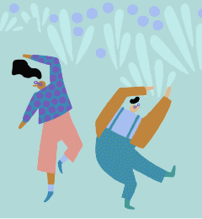
Fall-Free Outdoors
Keep sidewalks, porches and decks clear and in good repair
Use handrails on outdoor steps
Add an abrasive or rubber stair tread
Use a cane or walking aid
Wear sunglasses to reduce glare
Watch for changes in terrain as you walk
Notes:
Ensure that sidewalks, porches and decks are in good repair, no broken pieces or cracked concrete.
Handrails on outdoor steps are helpful for stability.
Some people will add an abrasive or rubber stair tread to prevent slipping on the steps.
Use a can or walking aid as recommended. Ensure it is properly fitted to you, a durable medical equipment company can help ensure proper fitting.
(personal story) my grandfather would use a walker in his home and a can when out and about to help him with his stability. He was a little bothered about using them at first, but then realized that by using the cane he felt more confident going out and would leave the house more often than before.
Wear sunglasses in the summer and winter to reduce glare and make it easier to see where you are placing your feet and what is ahead of you.
Watch for changes in terrain as you walk.
(personal story) My old neighborhood was an older neighborhood and as the trees had grow they had pushed up parts of the side walks. It was very important for me to watch for the sidewalk cracks so I wouldn’t trip.
Take your time, there is no need to rush. If we are out for a walk with someone who is moving a bit faster than we would like, we can ask them to slow down.
Ask for help with outdoor chores if you need or want help. Minnesota’s Senior LinkAge Line can provide referrals to chore programs in your area, some offer lower rates to older adults.

Slide 14
Decreasing your activity level means you won’t fall.
True or False?
Notes:
Ture or False, decreasing your activity level means you won’t fall.
False. Falls are common, but they aren’t normal. Improving strength and balance, managing medications, regularly getting your vision checked and making your living environment safer are ways to prevent falls. Many people fear falls, so they limit their activity levels to reduce falls, which can lead to reduced mobility and loss of physical fitness, which in turn increases the actual risk of falling.

Slide 15
Move Your Body
Bodies change as we age and may experience balance problems and loss of muscle
Moving your body can help prevent a fall
  30 minutes of exercise a day is recommended
  Break it into 10 to 15-minute blocks; it’s the daily total that matters
  Try an evidence-based program for fall prevention
Notes:
While we do lose muscle as we age, exercise can help restore strength and flexibility. Its never to late to start an exercise program.
Take a walk around your community. If you don’t like walking outside walk in your local community center or mall.
(personal story) One of my old neighbors would regularly walk the hallways in our apartment complex. Some people will go to the mall to walk before the store opens.
Look up an exercise program online or borrow a video from the library. We can adapt exercises to meet our needs.
Join a health club and attend their classes. Many secondary Medicare insurance options have a fitness benefit which reimburses the cost of a health club if an individual visits the club a certain number of times in a month.
It is ok to adapt exercises to meet our comfort level and/or what we have been approved for by our physician. 30 minutes of daily movement is what is recommended. You can break it into 10-to-15-minute blocks, it’s the daily total that matters.
Try a evidence-based program for fall prevention through Juniper

Slide 16

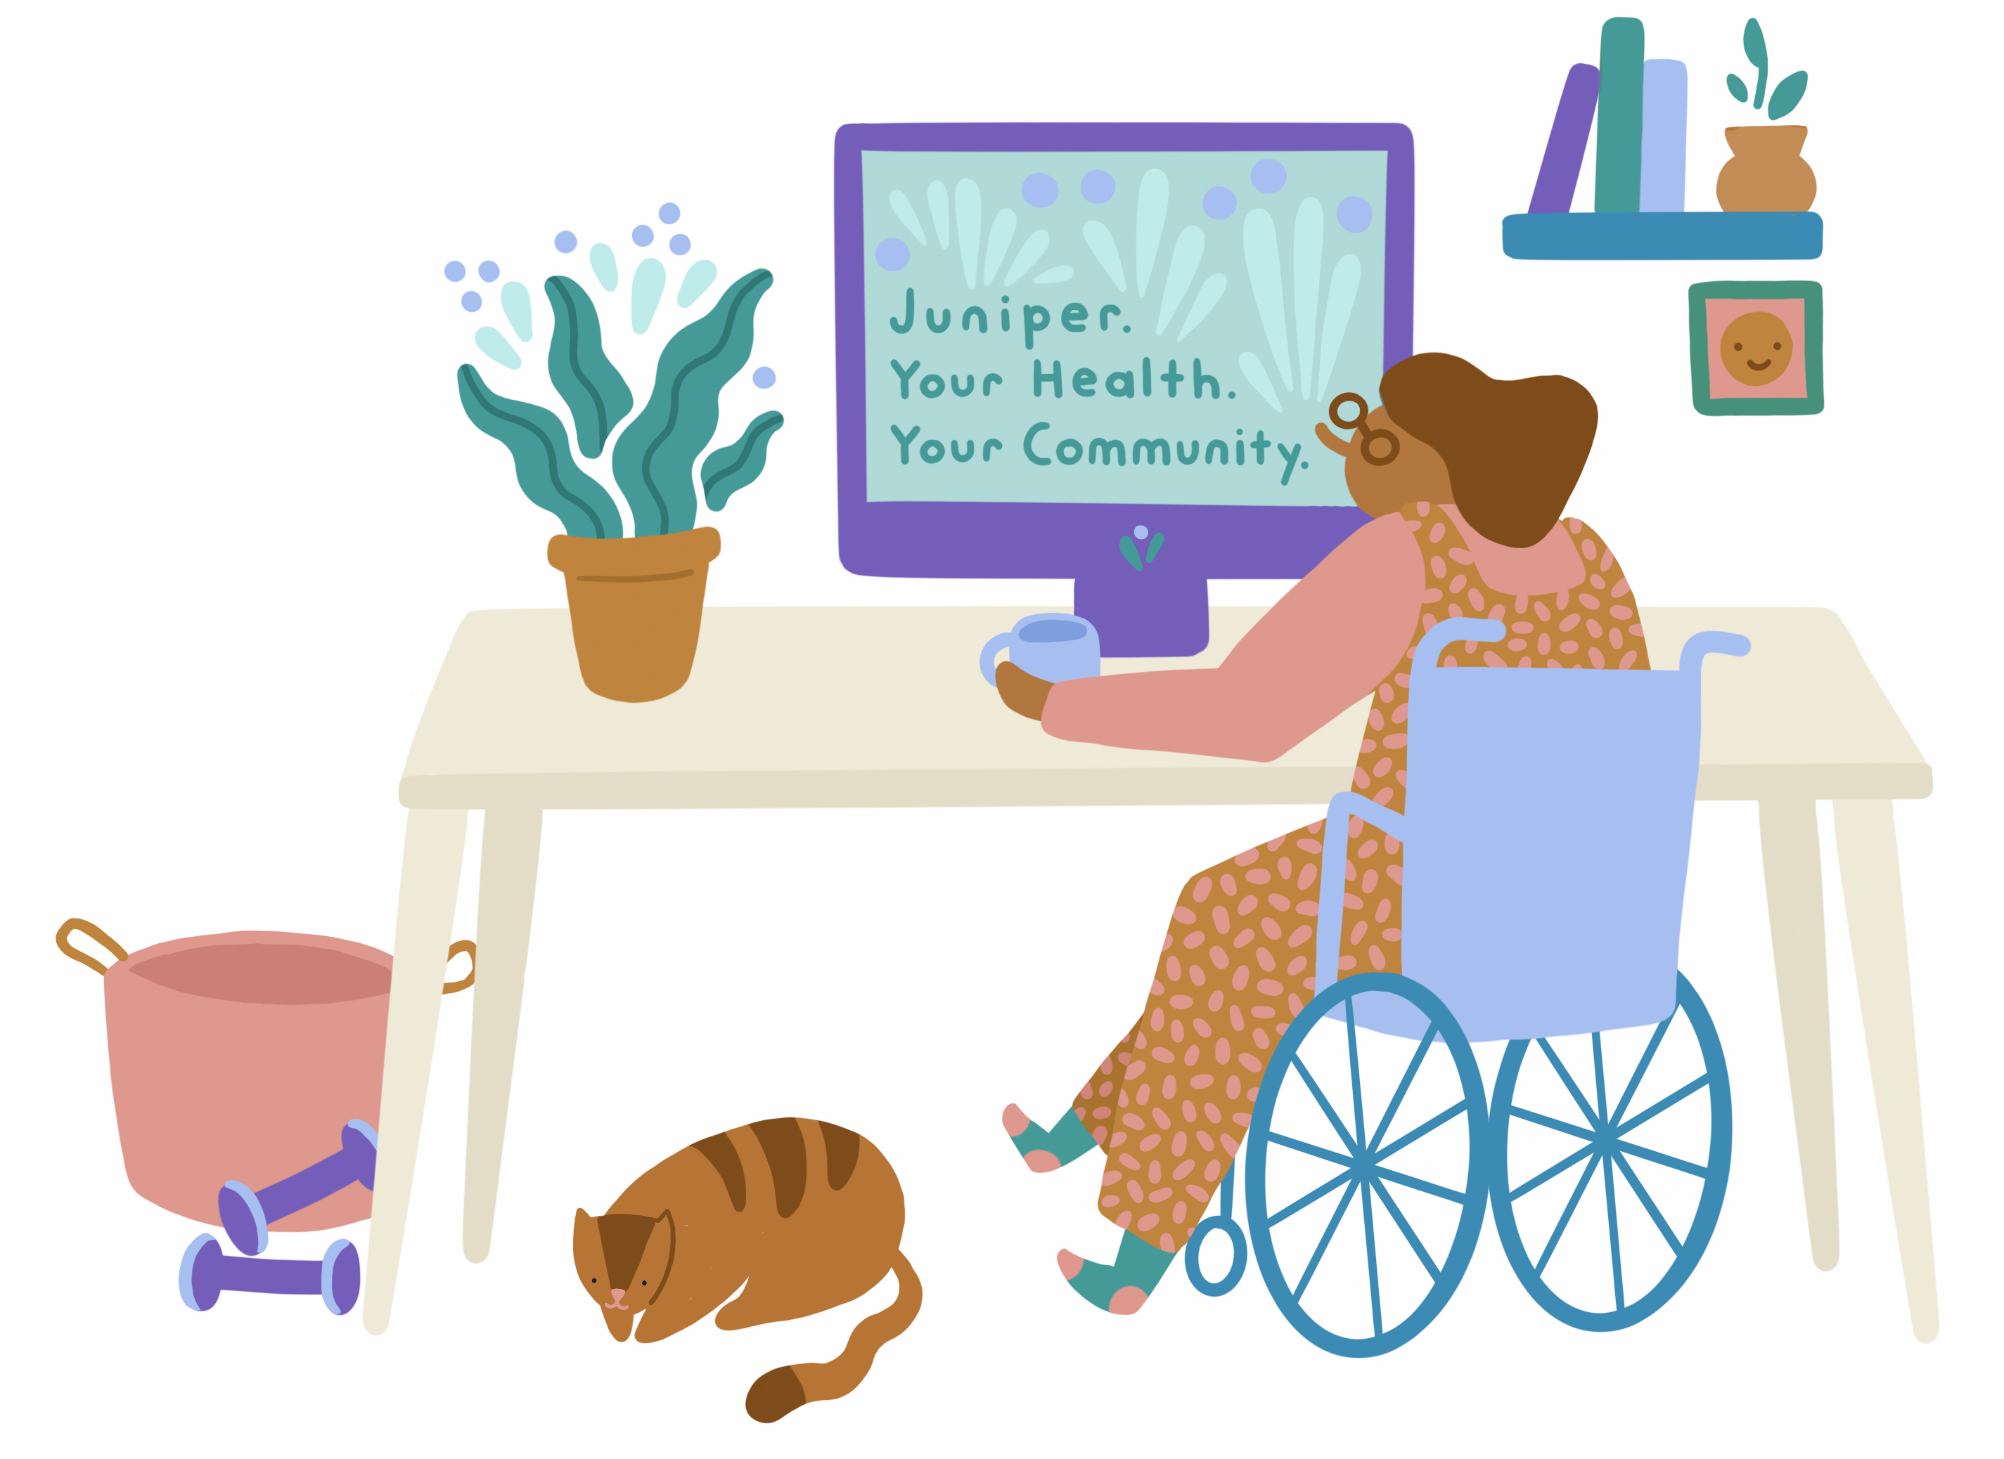
Free or low-cost classes for Minnesotans to live well, get
fit and prevent falls.
In-person and online
yourjuniper.org
1-855-215-2174
Notes:
Juniper is a network of community-based organizations that classes to help older adults in Minnesota live well, get fit and prevent falls. Classes are available online or in-person. Many classes are free, some classes have a small fee ranging from $10 to $25. The fee often covers the cost of the participant’s book, which you get to keep. Juniper offers 4 classes for fall prevention: A Matter of Balance, Stepping On, Tai Ji Quan: Moving for Better Balance and Stay Active and Independent for Life. Classes can be found at yourjuniper.org or by calling 1-855-215-2174.

Slide 17

A Matter of Balance
2 hours, once a week for 8 weeks
Address the fear of falling and learn practical solutions to fall prevention
Mix of lecture, discussion, exercise and activities
Stepping On
2 hours, once a week for 7 weeks
Identify individual fall risk related to vision, footwear, home hazards, and community safety
Mix of lecture, discussion, activities and exercise
Notes:
A Matter of Balance is a class that mixes discussion, lecture and activities. Seated exercises for balance are part of 5 of the 8 class sessions. Participants learn to see falls as something they can prevent, learn about practical solutions to fall prevention, and set goals for changes they want to make.
Stepping On is also a mix of discussion, lecture and activities. Guest speakers are brought in to talk to the group about how vision, footwear, medications and community safety play an important role in fall prevention. Group exercises for balance are led in three of the sessions.

Slide 18
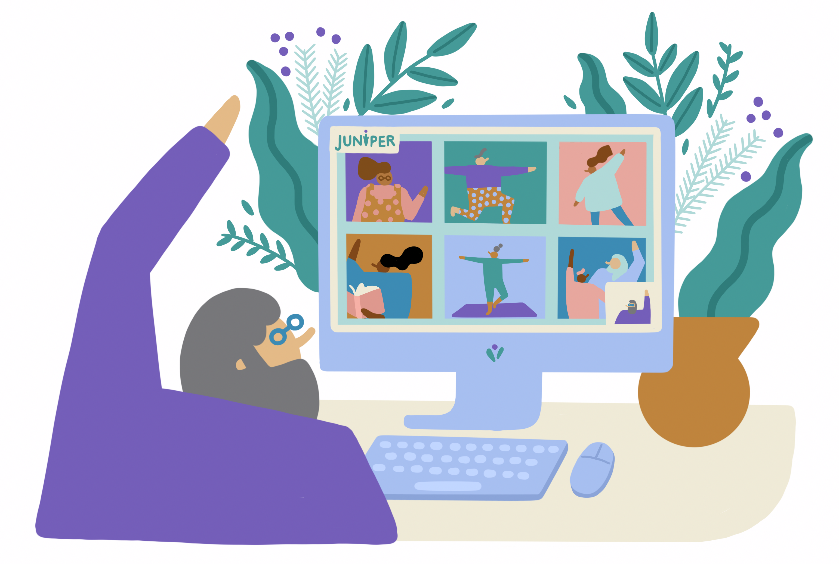
Tai Ji Quan: Moving for Better Balance
1 hour, twice a week for 12 weeks or three times a week for 8 weeks
Balance training program that uses Tai Ji forms and movements
No prior experience necessary, all ability levels welcome.
Stay Active & Independent for Life (SAIL)
1 hour, twice a week for 12 weeks or three times a week for 8 weeks
Aerobic, strength and balance exercises
No prior experience necessary, all ability levels welcome.
Notes:
Tai Ji Quan (pronounced: chu-ahn): Moving for Better Balance is a balance training program that uses traditional tai ji forms and movements to increase balance, coordination and endurance. No prior experience with Tai Ji is necessary. The class starts out by teaching you the basics, and progressively becomes more difficult. All ability levels can participate, the movements can be done seated or standing.
Stay Active and Independent for Life, or SAIL, is a exercise program for older adults that incorporates aerobic, strength and balance exercises. This class can also be adapted to all ability levels. The class does use some light weights and a small ball. If you’re taking the class online at home you can use what you have, if you are taking the class at a in-person site supplies will be provided for you.

Slide 19
Other Fall Prevention Tactics
Get your vision checked every year
Changes happen gradually, catch them before they become a problem
Check with your pharmacist for medication side effects
Taking 4+ medications increases the change of side effects
Take care of your feet
1 in 3 older adults experience foot pain*
Some conditions can cause foot numbness
*Source: J Foot Ankle Research
Notes:
Everyone's vision changes with age. As you get older your eyesight may become less clear, it may take longer to adjust to light and dark and distance and depth become harder to judge. These changes can happen gradually, and you might not always notice them. It is important to have your vision checked at least once a year – a tip to help you remember is to schedule a vision appointment around the time of your birthday. And, as you likely know, vision is not covered under original Medicare. If you know of someone who cannot afford eye care, call the Senior Linkage Line to see if we can help find vision resources.
It is also important to check your medications for side effects. We know that medicines or many medicines combined together, can make you feel dizzy, drowsy and light-headed. And many of us, especially as we age, take multiple medications to manage our conditions. In fact, it is estimated that least 80% of older adults deal with a chronic condition and 50% or more have 2 or more conditions.
If someone takes 4 or more medications, the chance of experiencing side effects increases. 4 medications is not a lot when you include prescriptions, over-the-counter remedies, vitamins and herbal supplements. It is really important to talk with your pharmacist and doctor about all of your medications and side effects. Pharmacists are good at looking at drugs and knowing the consequences between medications. Additionally, be careful consuming alcohol while taking medications. If you talk to your pharmacist and make changes to your medications, Senior LinkAge Line can provide counseling to ensure your prescriptions are covered under your Medicare part D plan.
1 in 3 older adults experience foot pain. If your feet hurt, you will be less active which can contribute to a risk of falling. Other conditions, like neuropathy, can cause numbness in your feet making it difficult for you to feel and react to changes in terrain. Keep feet clean, dry and trim toenails regularly. Some senior centers and social service organizations offer foot care clinics. If you don’t have access to a foot care clinic, consider a pedicure at a nail salon. Wear shoes that fit and are comfortable with good soles. Avoid slip-on slippers, they can be fall hazards. Finally, for any medical conditions causing you to lose sensation in your feet, be sure to follow the care regimen recommended by your health care provider.

Slide 20
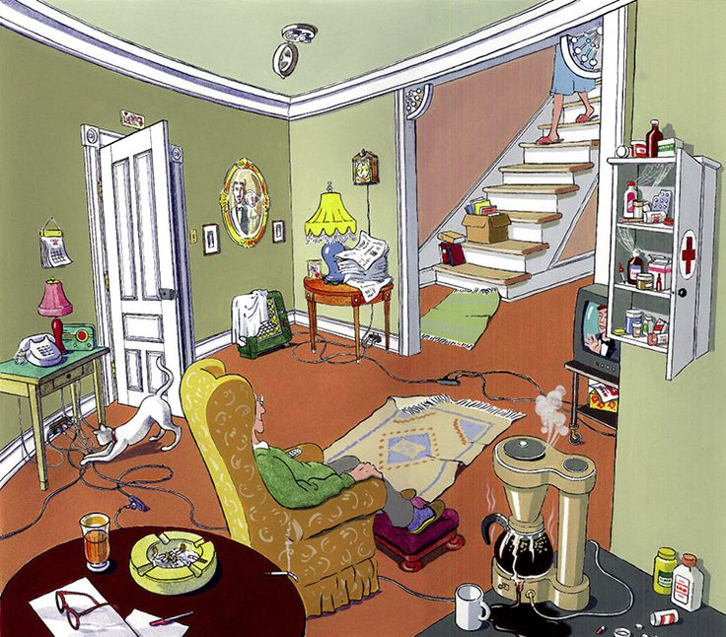
Activity
What
fall hazards
do you see in this image?
Notes:
Now for an activity to apply all the tips we’ve learned! This image has a lot of safety hazards, but what I want you to focus on is what are the fall hazards. Please take a few minutes to identify the fall hazards in this picture.
(pause for about 2 minutes)
Alright, what are the fall hazards that you identified? (you can ask people to use the chat or unmute on Zoom, in-person people can share aloud).
Stairs without a handrail
Loose extension cords in traffic areas
Loose rugs
Flip-flop slippers
Clutter on staircase
Pet
Not wearing glasses
Only two lamps, dark room?
We might conclude that their medications are not being taken correctly

Slide 21
In Summary
Falls are preventable
An older adult can lower their chances of falling by following simple suggestions and ideas
Adopting some of these tips will help us:
  Stay independent
  Feel good
  Enjoy life more
Notes:
Thank you everyone for your time today. Today we learned that falls are preventable, an older adult can lower their chances of falling by following simple suggestions and ideas. Adapting some of these tips will help us stay independent, feel good, and enjoy life more.

Slide 22
Senior Linkage line® can help
Call 800-333-2433
Monday – Friday
8:00 am to 4:30 pm
Medicare counseling by calling SLL or by appointment
Presentations in the community on Medicare, about SLL, health fraud, etc. - request a presentation
The Senior LinkAge Line® is a free statewide service of the Minnesota Board on Aging in partnership with Trellis.
Notes:
In this presentation I cited Senior LinkAge Line. Senior LinkAge Line is a service of Minnesota that older adults and caregivers can call to find resources in their community to make home more accessible and for chore services, and get help with Medicare. They are open Monday through Friday, 8am to 4:30pm.

Slide 23
Thank you!
Contact me
[Name, [Title]
[email]
Notes:
Thank you again for your time. Are there any questions?

