Slide 1
Tips for Conducting Virtual PTC Classes
powerfultoolsforcaregivers.org

Slide 2
GENERAL
Outreach, participant registration and leader roles mostly unchanged
Promotional materials include tech requirements
OK: computer or large tablet with microphone, camera and reliable internet connection
Not OK: small tablets or cell phones
Confirm that caregivers have appropriate technology during registration
If using personal hotspot, Zoom uses LOTS of data!
Class size: 8-10 with maximum of 12 participants

Slide 3
GETTING READY
Select virtual meeting software
Popular examples: Adobe Connect, GoToMeeting, RingCentral, Skype, VSee, WebEx, Zoom
Practice using selected software with co-leaders
Most companies offer virtual tutorials in YouTube format
Decide which leader will be software host
Some software tasks can only be done by host
Others can be done by either host or assigned co-host
Today’s examples based upon Zoom

Slide 4
HOST TASKS – ONE TIME ONLY
Log into account at zoom.us via web browser to confirm needed features are activated in Settings:
Passcode (optional)
Waiting room (default)
Host and participant videos on when meeting starts
Mute participants upon entry
Chat
Co-host
Screen sharing (host only)
Allow participants to rename themselves
Breakout room
Virtual background

Slide 5
HOST ONLY TASK – SCHEDULE MEETINGS
Schedule Orientation and 6-week class
Set up 6-week class as Recurring meeting
Zoom link the same for all 6 classes
Log into zoom.us (or schedule via email, if integrated)
Go to Schedule a Meeting
Enter date of the 1st weekly class, start time, and select length of time for meeting
Select Recurring meeting, then Weekly, Every 1 week, day of week, and either date of last class or after 6 classes
Set passcode for extra security, if desired
Waiting room selected by default

Slide 6
HOST ONLY TASK - INVITATIONS
After creating and saving meeting, next screen has Invite Link and button to Copy Invitation
Copy the invitation into your email program to send to each participant, along with any additional details, attachments, etc.
Do not use email meeting invitation, such as Outlook meeting invitation; send direct emails
For recurring meetings, invitation list all the dates

Slide 7
HOST ONLY TASK - BREAKOUT ROOM
For pairs activity, allow software to randomly assign participants to rooms with 2 participants
If an odd number of participants, pair extra with co-leader
Can assign a specific time length to Breakout room session or manually end them
Can broadcast text message into Breakout rooms
For 10-minute pairs activity, at 5 minutes, broadcast reminder to switch who is sharing

Slide 8
HOST & CO-HOSTS TASKS
Host starts and ends the virtual meeting
Can log in any time prior to start time and stay afterwards
Co-leader(s) are in Waiting room until host admits them into the meeting
Immediately assign co-host role to co-leader(s)
Same access to most in-meeting controls as host
Can take over in case host loses connection to meeting or has an emergency
Host losing connection doesn’t end meeting!

Slide 9
OTHER HOST TASKS
Admit participants from Waiting room
See list of all participants
Mute-unmute everyone
Chat privately and with everyone
Lower participant “raise hand” feature
Access video and audio files on PTC website
Share screen when playing video and using PowerPoint
Enter text into PowerPoint tables
Understand different ways to view meeting
Know what to do if someone loses connection to meeting

Slide 10
WAYS TO VIEW MEETING
Full screen or not?
Leaders should not use full screen so can have both Zoom and PowerPoint visible to keep slides advanced
Speaker vs Gallery?
To help create a feeling that one is in a group class, always use Gallery view
If see Speaker button, correctly in Gallery view
Select Side-by-Side during Screen share, and adjust relative sizes of Gallery and Screen share
Leader who is screen sharing will need to select view as grid and resize floating Gallery window to see everyone

Slide 11
ORIENTATION
Hold prior to first class to ensure caregivers can:
Log into Zoom using invitation link in email from leaders
Understand Waiting room
Turn video on and position camera so easily seen
Rename themselves as their first names
Mute/unmute microphone
Adjust computer volume
Use “chat” feature
Use “raise hand” feature
Select and adjust Gallery view to see everyone
Enter Breakout room and leave correctly
Know what to do if lose connection to Zoom
LET’S PRACTICE!

Slide 12
USING CLASS MATERIALS VIRTUALLY
Prior to first class, email Handouts PDF packet, Class evaluation PDF form, and Local Resources handout to caregivers (or print and mail them)
Will need to adapt script to accommodate differences between in-person and virtual classes
Review scripts and make notes about changes
Only use digital visual aids
“I Am a Caregiver” video from PTC website or computer
Guided meditation(s) from PTC website or computer
PowerPoint on computers

Slide 13
LOGISTICS FOR WEEKLY CLASSES
Send email reminders that include Zoom link a day or two prior to each weekly class
Leaders log into Zoom at least 15-20 minutes prior to start time
Cue up all audio-visuals being used in the class and minimize until selected for Screen share
Participants encouraged to join 5-10 minutes prior to start time

Slide 14
LOGISTICS FOR WEEKLY CLASSES
Make sure everyone has cameras positioned so faces are easy to see and individual screens are labeled with first names
Teamwork between co-leaders helps ensure caregivers are acknowledged in a timely manner
At all times, watch for chats, missing participants, unmuted participants, and raised hands
Mute and lower digital raised hands if caregiver forgets to do it

Slide 15
FACILITATION TIPS
Facilitate the workshop just as you would in-person (facilitating all activities completely, modeling, managing group dynamics, etc.)
Allow extra time for silence when you ask ONE question at a time (individuals may experience a time delay)
For brainstorming and problem-solving, remind caregivers of your preference: use digital “raise hand” feature or physically raise hand

Slide 16
FACILITATION TIPS
Look for opportunities in script for when you do not need to share PowerPoint screen for charts and brainstorms
Place sticky notes in script to “stop share screen” and “start share screen” as reminders
Add sticky notes to script to indicate which leader will control the PowerPoint slides to screen share and/or enter text in the brainstorm tables.
For example, “Sally scribes” or “Jill screen shares”

Slide 17
FACILITATION TIPS
If Breakout room feature doesn’t work, instead of “pair and share”, have caregivers report for themselves; model this first
Learn to speak directly to the camera—as opposed to looking up or down, at participant window or yourself—to help create the feeling that you are connecting with everyone

Slide 18
PARTICIPANT SAFETY & CONFIDENTIALITY
As with in-person class, watch for signs/symptoms of depression, suicidal ideation and abuse and refer caregivers to resources available for support
Protect the confidentiality of caregivers just as you would for an in-person workshop
Do not record workshop sessions
Do not allow guests, including the care receiver
Pets are allowed!

Slide 19
USING POWERPOINT VIRTUALLY
During planning process, decide how to share PowerPoint responsibilities
When one leader is facilitating, the other can share screen, advance slides and enter text for brainstorming
Not recommended: using “remote control” of PowerPoint
Use mouse cursor to point to items on slide or pointer tool available in virtual meeting software

Slide 20
DEMONSTRATE USING POWERPOINT
Brainstorm slides use tables for entering responses
Place mouse cursor in first cell, then use tab key or up/down arrow keys to move from field to field
Must stay in Design/Edit mode to enter text in tables
Maximize size of PowerPoint slides
Don’t save PowerPoint file
Use a copy of the PowerPoint slides

Slide 21
USING SLIDES FOR BRAINSTORMS
Name | Cares for | Primary Medical Condition

Slide 22
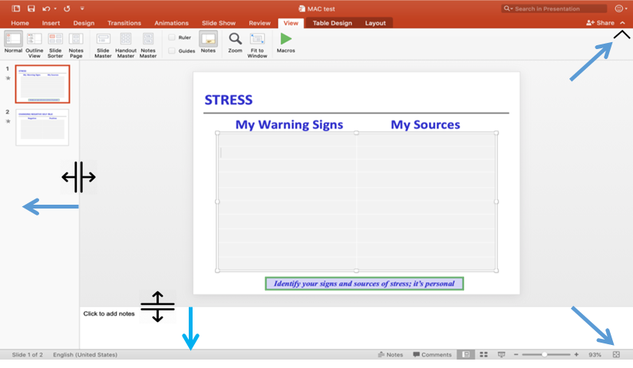
Normal view - with steps to maximize slide size

Slide 23
View after maximizing slide size

Slide 24
Questions?
Leslie Congleton, Co-founder/Program Director
leslie@powerfultoolsforcaregivers.org
Helena Wolfe, Master Trainer
lightwolfdesign@yahoo.com

